Slide 1
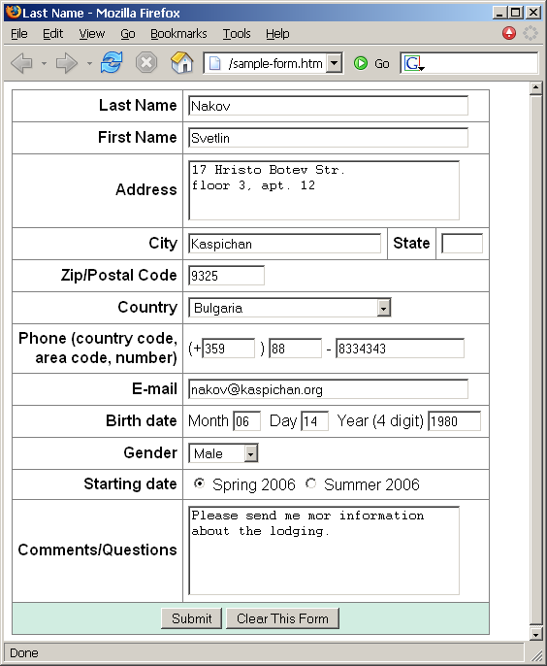
Create a Web form that looks like this sample:

Slide 2
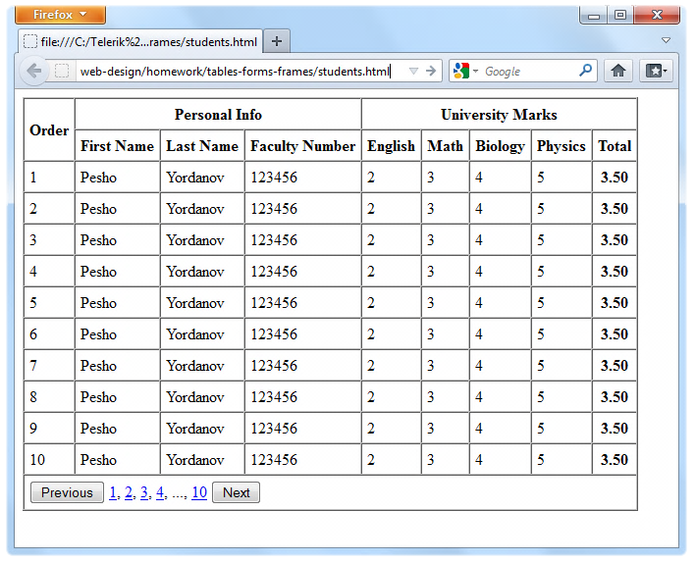
Homework (2)
Create the following using tables and forms:

Slide 3
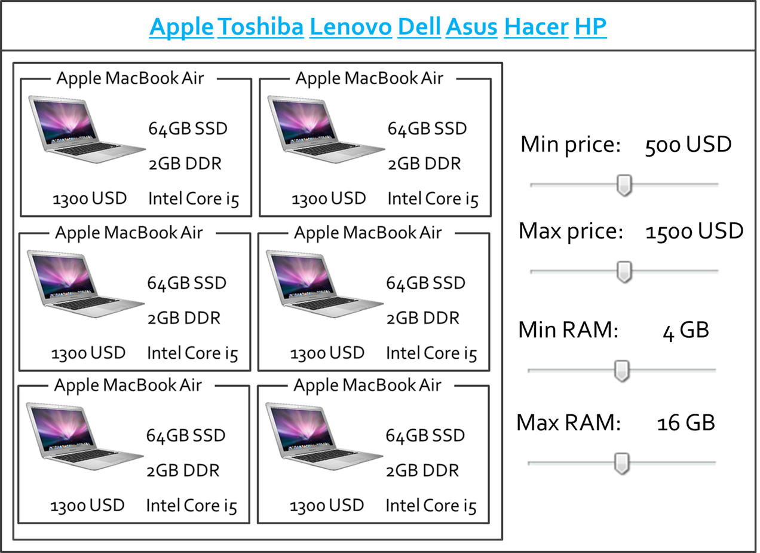
Homework (3)
*Create the following HTML Page
Hint: Use Fieldsets and Nested tables

